Slide 1
Physics of light & material

Slide 2

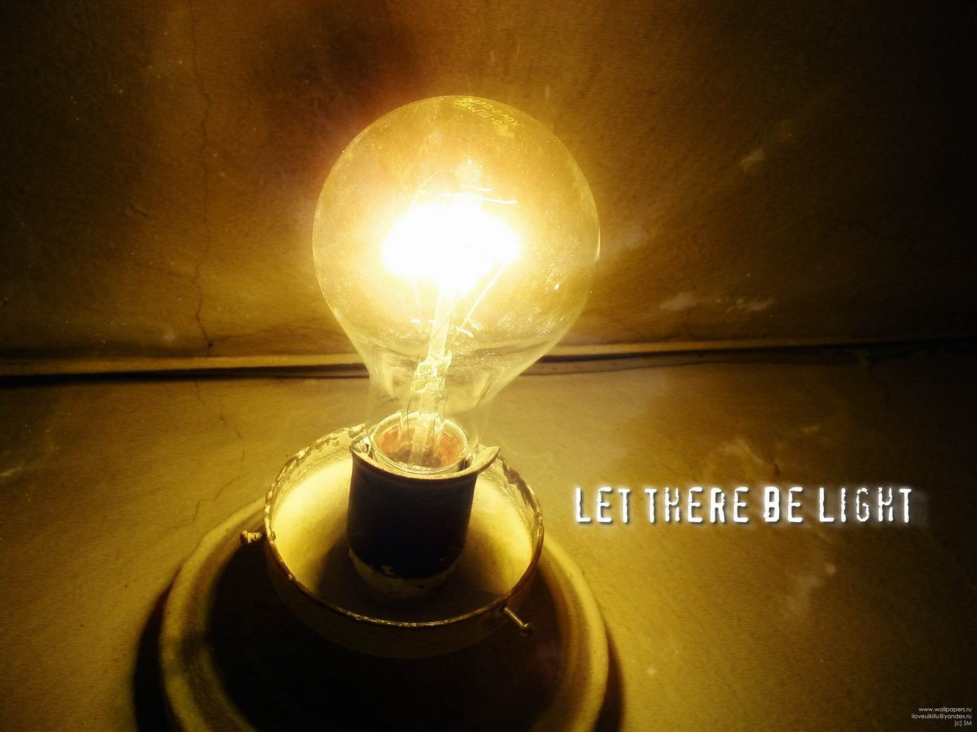
What is light

Slide 3
Wave / Particle

Slide 4
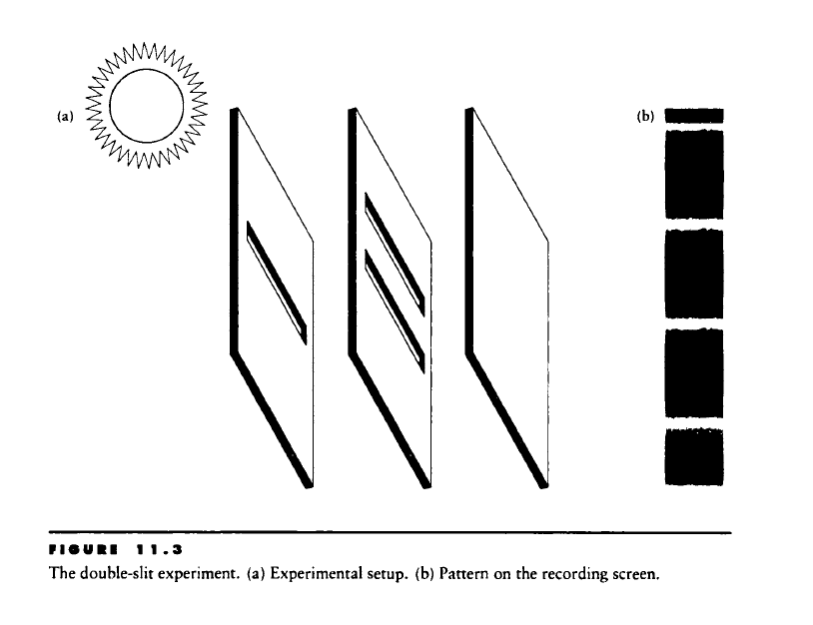
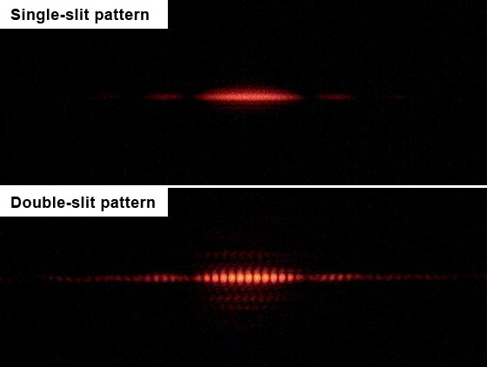
Double slit experiment
http://en.wikipedia.org/wiki/Double-slit

Slide 5
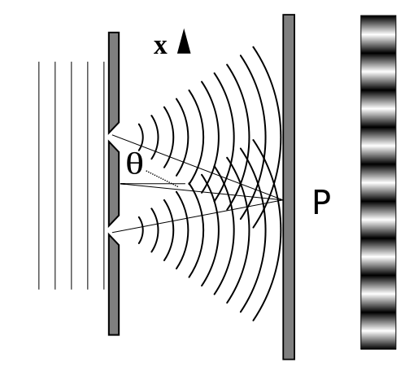
Double slit experiment

Slide 6
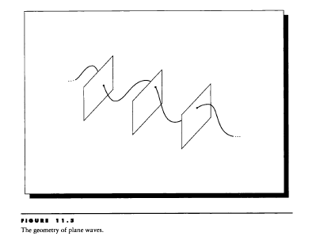
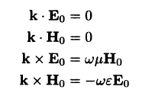
Wave nature of light
Maxwell equation
  Light is electromagnetic wave

Slide 7
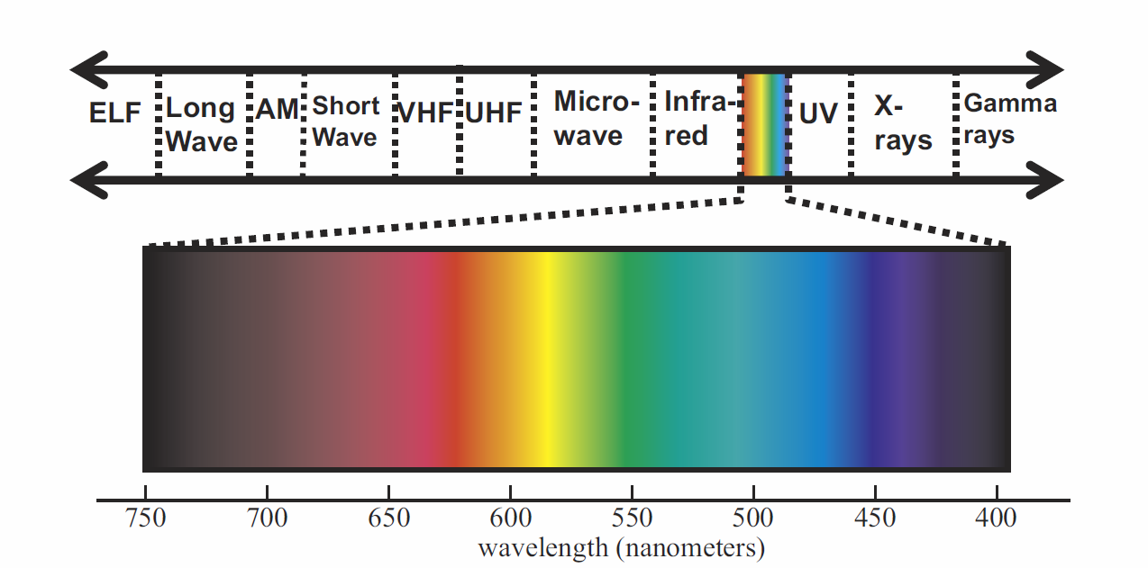
Wave nature of light

Slide 8
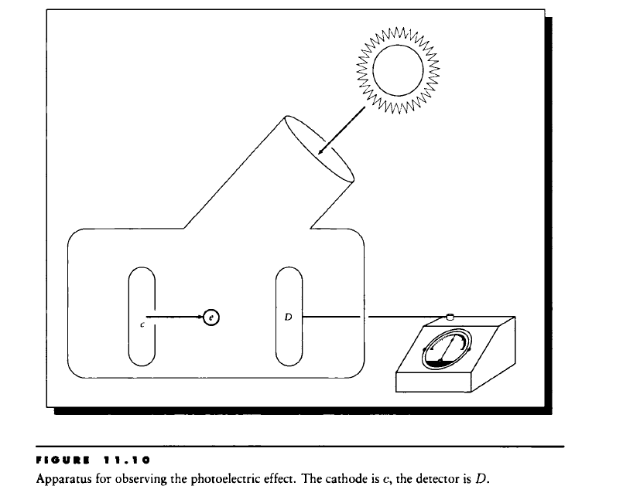

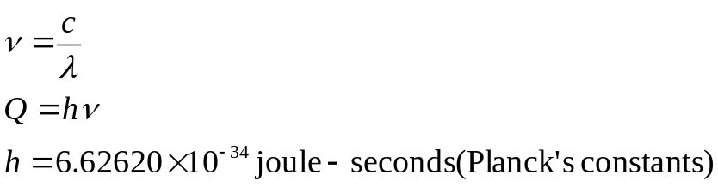
The Phetoelectrlc Effect

Slide 9
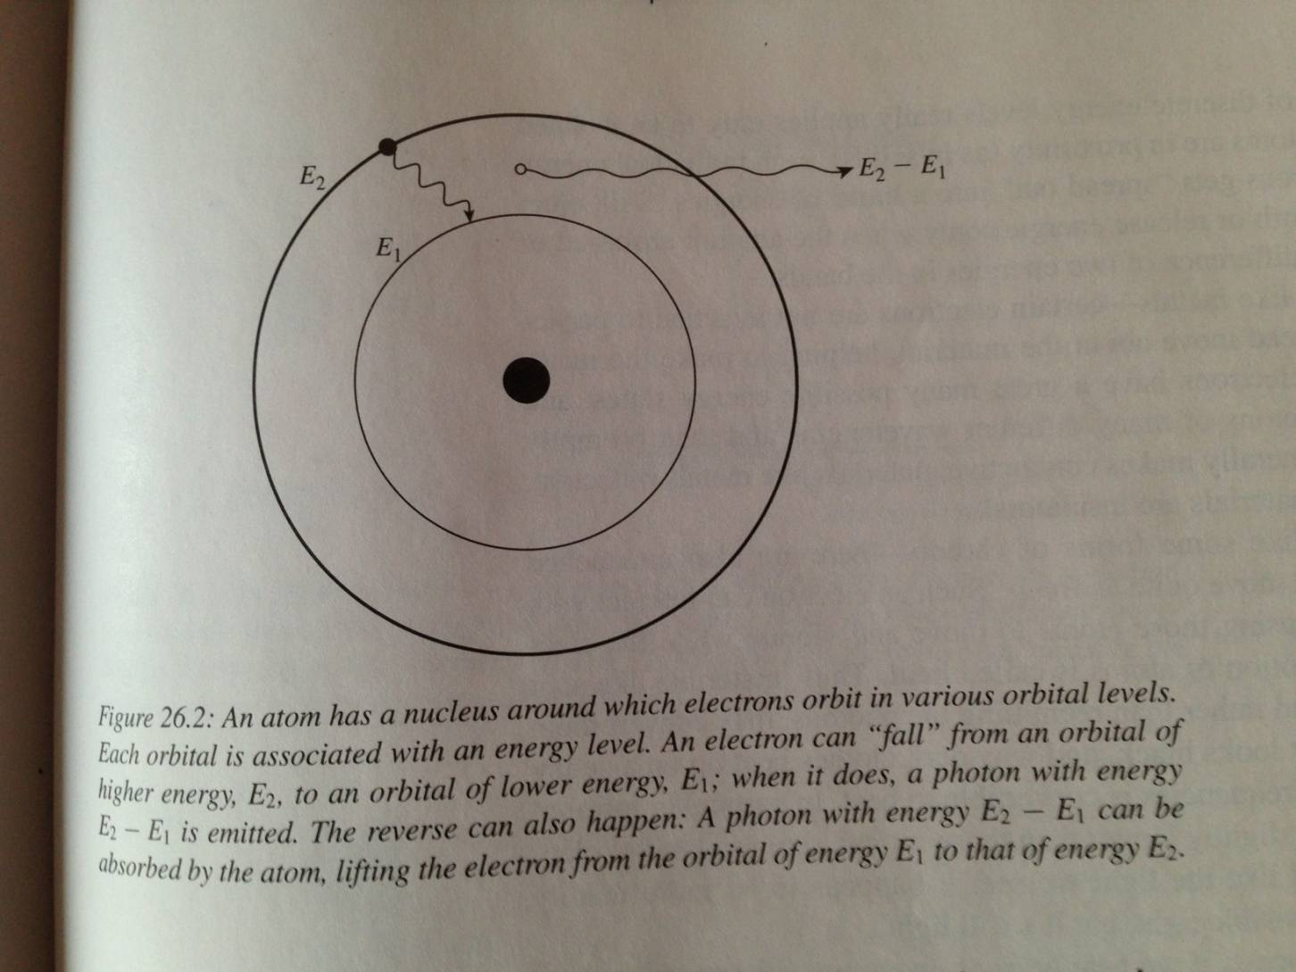
Light as particle

Slide 10
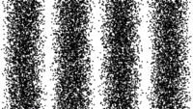
Quantum mechanics
Wave particle duality
  http://en.wikipedia.org/wiki/Wave%E2%80%93particle_duality
Complementarity
  http://en.wikipedia.org/wiki/Complementarity_(physics)

Slide 11
Light propagation & material
Maxwell equation
  大致上來說，在真空或單一均勻介質中，光是直線傳遞，傳遞方向與電波動方向垂直

Slide 12
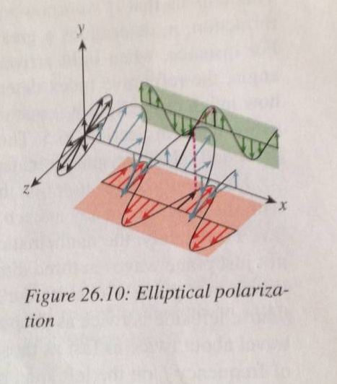
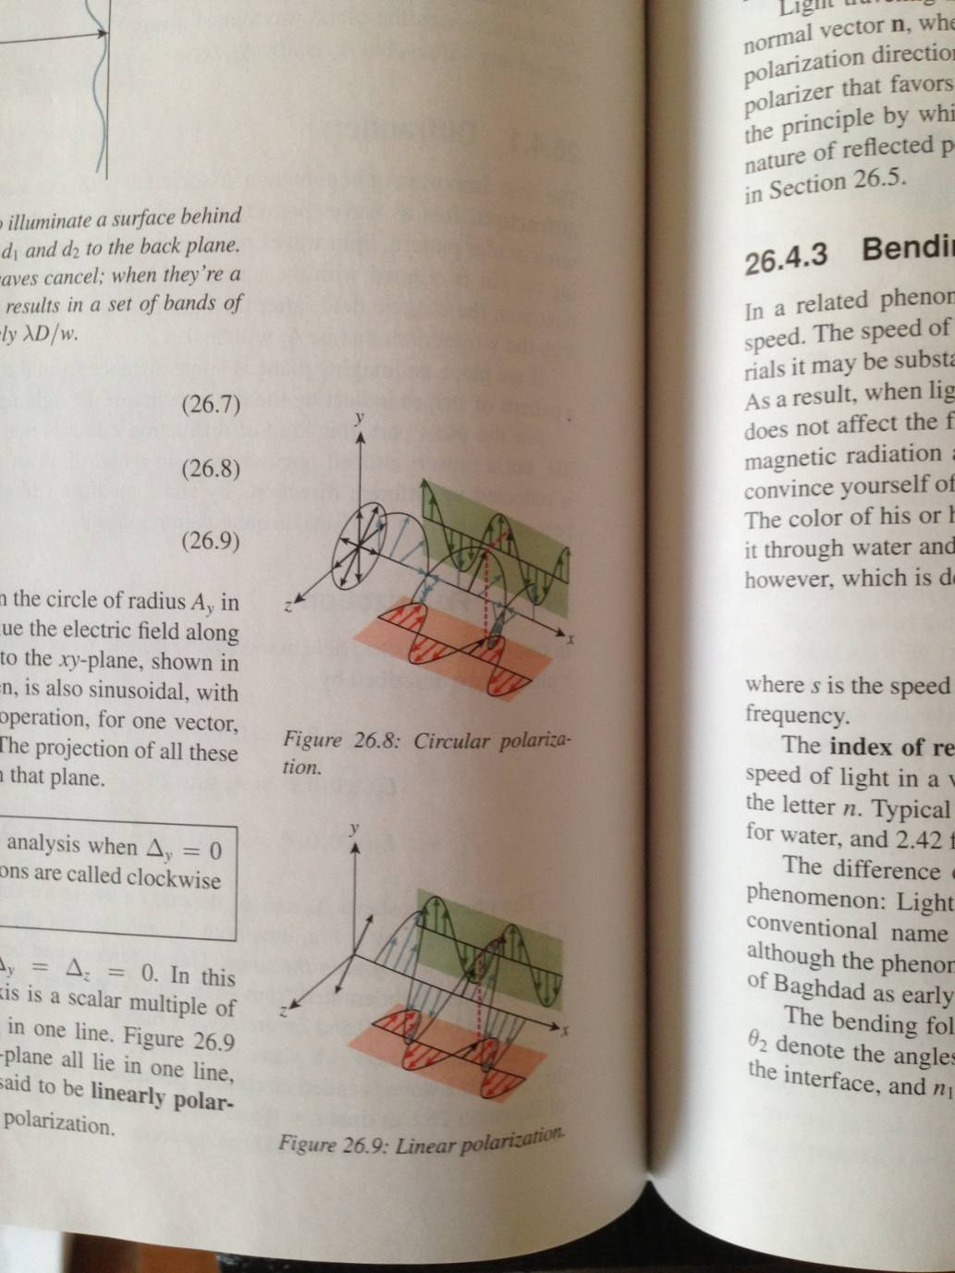
Polarization
但在三維空間中，與一直線垂直的方向有很多
光有三種偏振(polarize)的型態
  光被光滑表面反射後，會呈現linear polarize
  Polarizer

Slide 13
Material
光傳遞過程中，如果遇到介質改變，行進方向會改變
  如果介質緩慢改變，光會走曲線
Computer graphics中關心的，大多是兩介質突然改變的介面
  假設兩介質表面完全平滑，平坦而且無限大
  光會分為兩個方向，一部分反射，一部分折射，然後繼續直線前進

Slide 14
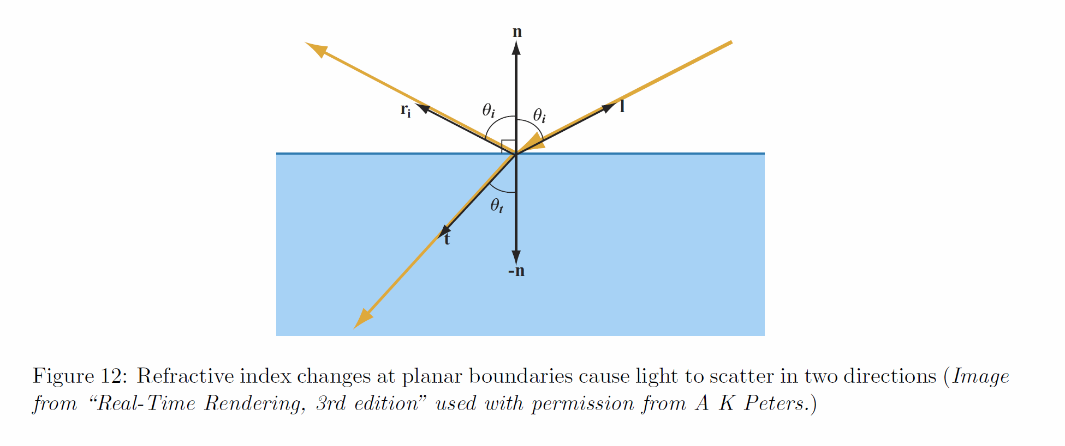

Slide 15
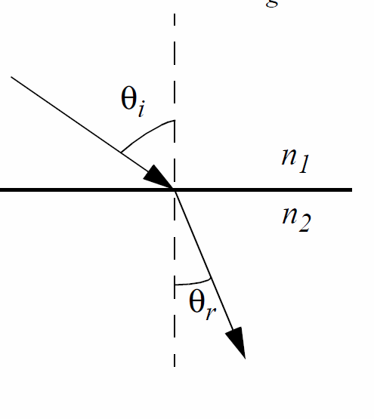
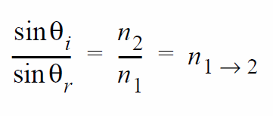
Refraction
Snell’s law

Slide 16
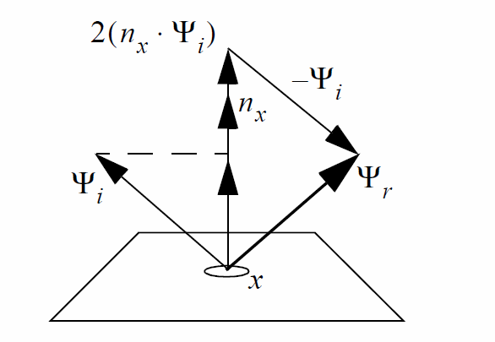
Reflection
光經過光滑表面反射後，會呈現兩個linear polarize方向
P-polarize – (parallel polarize)與介質表面平行
S-polarize – 位於入射和反射方向所形成的平面上

Slide 17
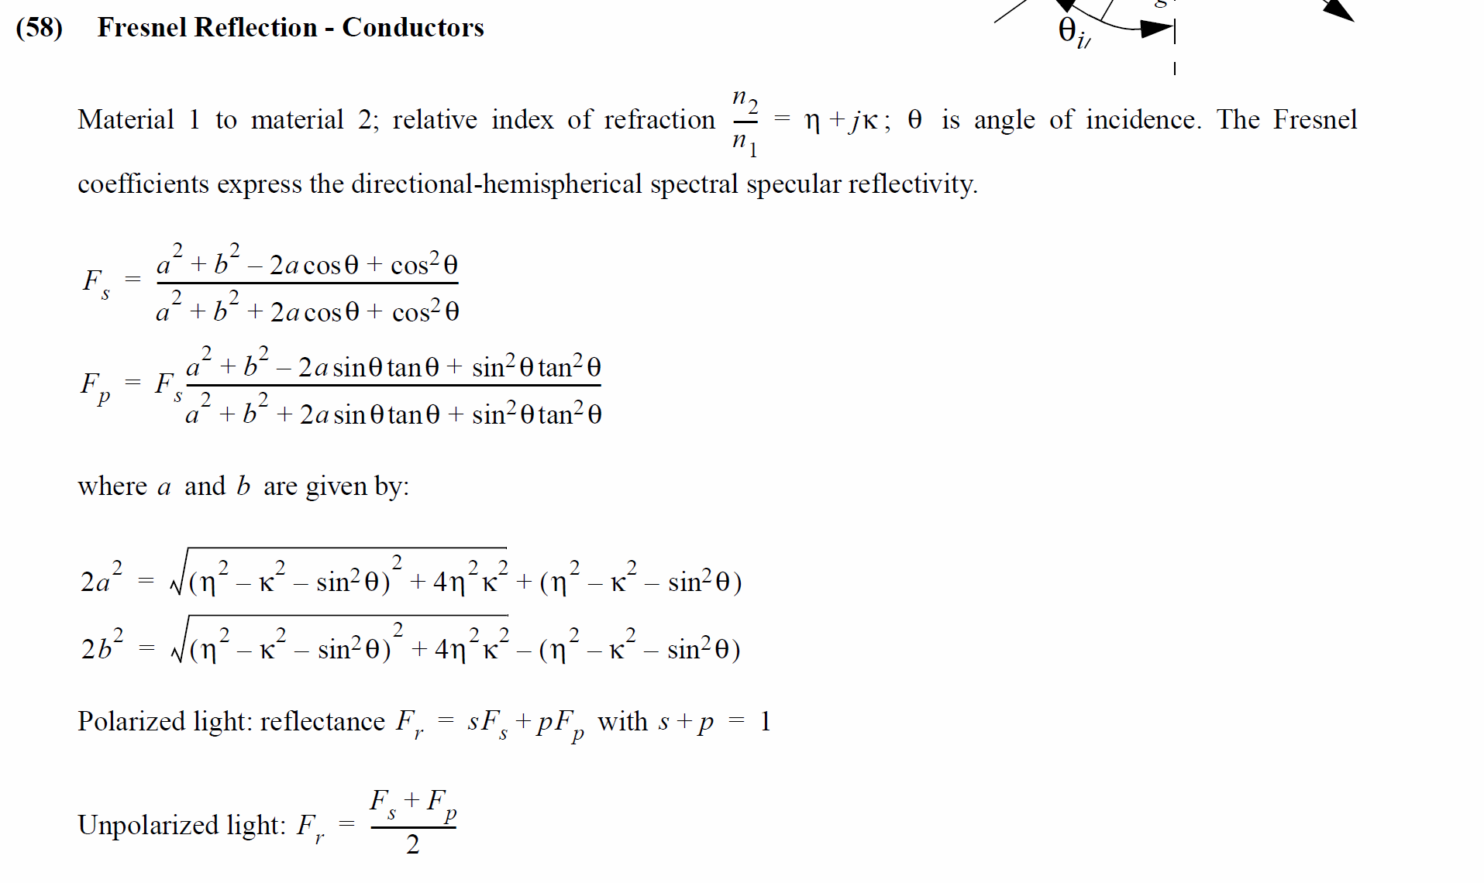
Amount of reflection
Fresnel – Global Illumination Compendium, p29

Slide 18
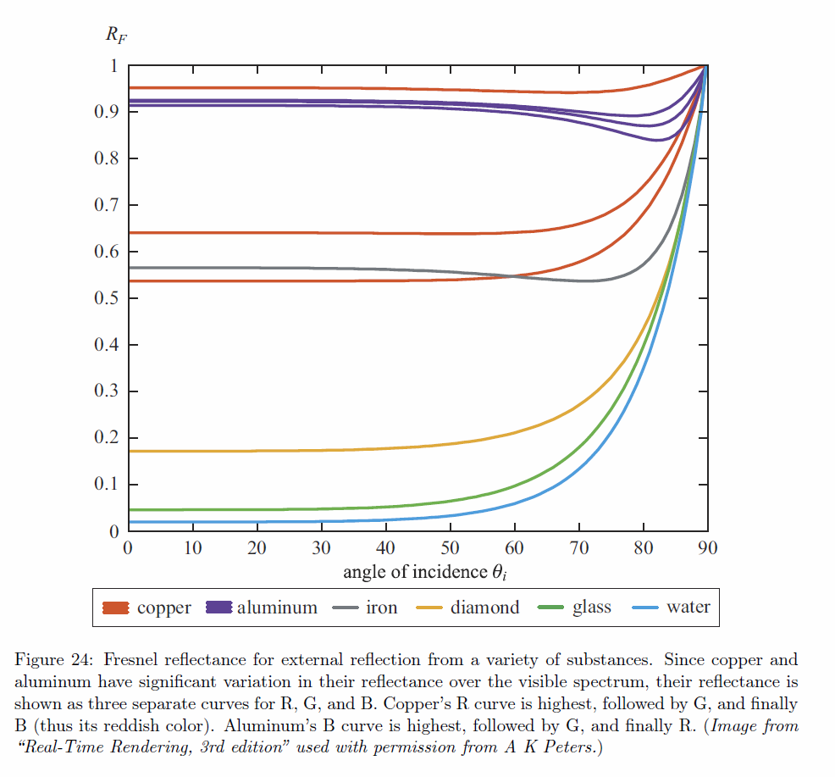

Fresnel in Computer graphics
Computer graphics通常忽略polarization，使用Schlick approximation

Slide 19

Microfacets BRDF
Fresnel !!!

Slide 20
Recommended reading
Real time rendering 3rd ed Chpater 7
Principles of digital image synthesis Chapter 11
  http://www.realtimerendering.com/Principles_of_Digital_Image_Synthesis_v1.0.1.pdf
Global Illumination Compendium, p26~p30
  http://people.cs.kuleuven.be/~philip.dutre/GI/
Computer graphics principles and practice 3 rd chapter 26

Slide 21
Next course
Real time rendering 3rd ed Chpater 7
Siggraph 2012 Physically based shading course
  Background: Physics and Math of Shading
  http://blog.selfshadow.com/publications/s2012-shading-course/hoffman/s2012_pbs_physics_math_notes.pdf
Advanced
  Walter, Bruce, Stephen R. Marschner, Hongsong Li, Kenneth E. Torrance, \Microfacet Models for Refraction through Rough Surfaces," Eurographics Symposium on Rendering (2007)
  Siggraph 2013 physically based shading course
    Real Shading in Unreal Engine 4

